Slide 1
Machine Learning – (Linear) Regression
Wilson Mckerrow (Fenyo lab postdoc)
Contact: Wilson.McKerrow@nyumc.org

Slide 2
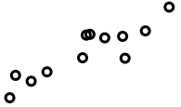
Linear Regression – one independent variable
Data:
Want:
(residual) is “small”
2
Predictor
Independent
Response
Dependent

Slide 3
Linear Regression – one independent variable
3
What is “small”?
Define a loss function:
To measure how far off the model is.
Want:

Slide 4
Linear Regression – one independent variable
4
Standard choice: Sum of square errors (least squares)

Slide 5
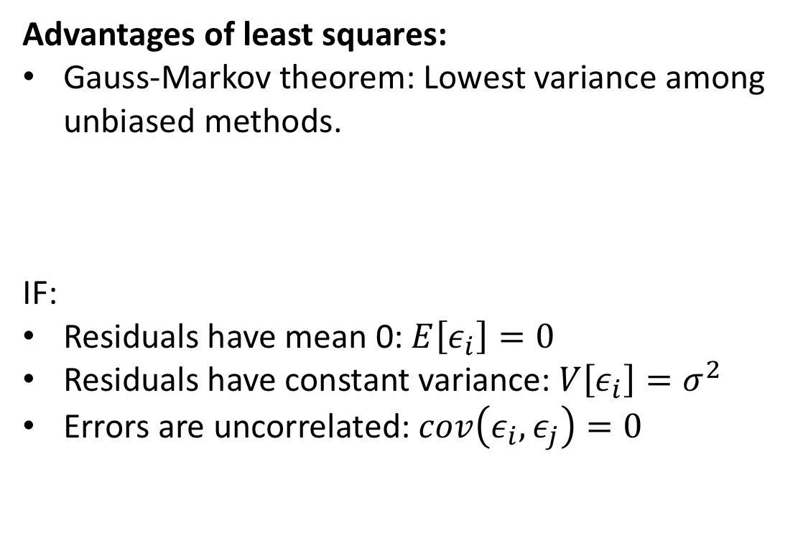
Linear Regression – one independent variable
5
Advantages of least squares:
Gauss-Markov theorem: Lowest variance among unbiased methods.
IF:
Residuals have mean 0: $E\left[ε_{i}\right]=0$
Residuals have constant variance: $V\left[ε_{i}\right]=σ^{2}$
Errors are uncorrelated: $cov\left(ε_{i},ε_{j}\right)=0$

Slide 6
Linear Regression – one independent variable
6
Advantages of least squares:
Gauss-Markov theorem: Lowest variance among unbiased methods.
Equivalent to MLE for

Slide 7
Linear Regression – one independent variable
7
Advantages of least squares:
Gauss-Markov theorem: Lowest variance among unbiased methods.
Equivalent to MLE for
Easy to calculate

Slide 8
Linear Regression – one independent variable
8
Disadvantages of least squares:
Variance can still be large
Pays attention to outliers

Slide 9
Linear Regression – One Independent Variable
9
Minimizing the loss function, L (sum of squared errors):

Slide 10
Linear Regression – One Independent Variable
10
Minimizing the loss function, L (sum of squared errors):

Slide 11

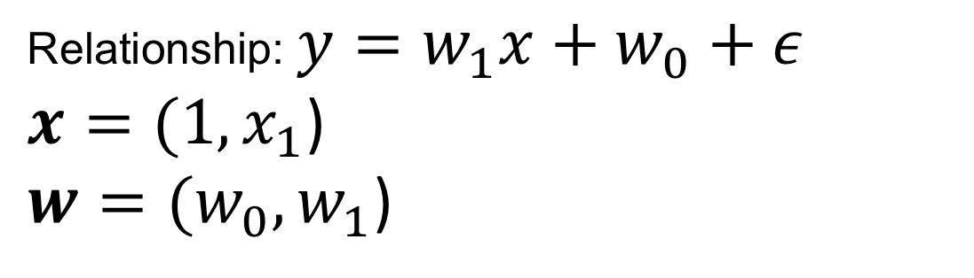
Linear Regression – Vector notation
11
Relationship: $y=w_{1}x+w_{0}+ε$
$x=(1,x_{1}$)
$w=(w_{0},w_{1}$)
$$y=x∙w+ε$$

Slide 12

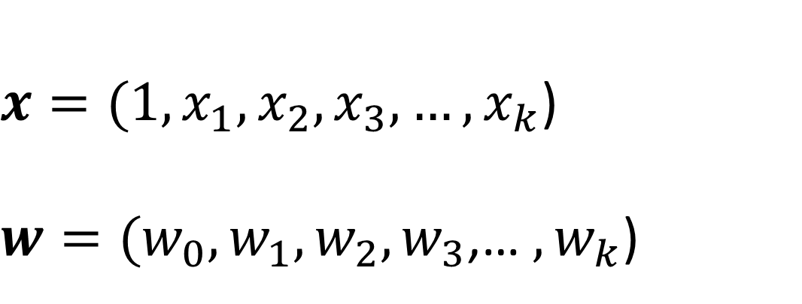
Linear Regression - Multiple Independent Variables
$$y=x∙w+ε$$
12
$x=(1,x_{1},x_{2},x_{3},…,x_{k}$)
$w=(w_{0},w_{1},w_{2},w_{3}$,… $,w_{k}$)

Slide 13

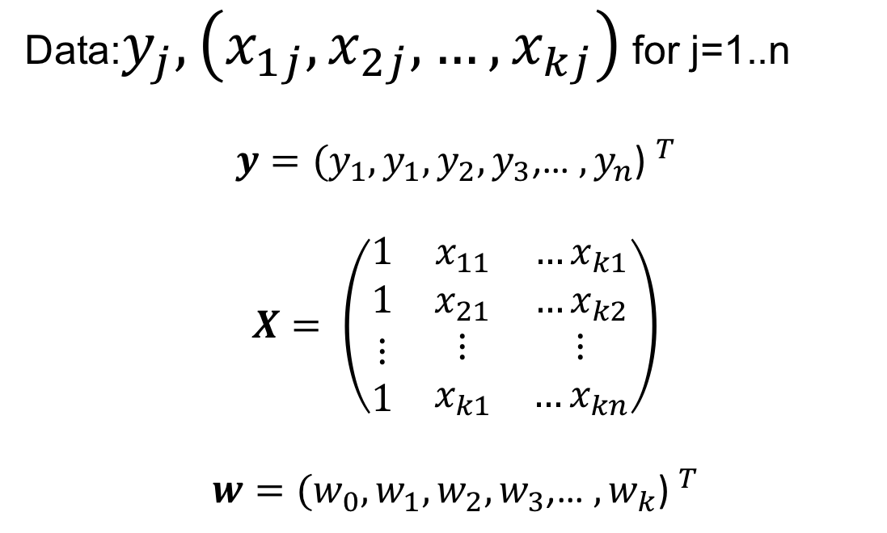
Linear Regression – Matrix notation
13
$$y=Xw+ε$$
Data:$y_{j},\left(x_{1j},x_{2j},…,x_{kj}\right)$ for j=1..n
$$y={(y_{1},y_{1},y_{2},y_{3}\text{,… },y_{n}\text{) }}^{T}$$
$$X= \left(\begin{matrix}1 & x_{11} & …x_{k1} \\ 1 & x_{21} & {…x}_{k2} \\ \begin{aligned}⋮ \\ 1\end{aligned} & \begin{aligned}⋮ \\ x_{k1}\end{aligned} & \begin{aligned}⋮ \\ …x_{kn}\end{aligned}\end{matrix}\right)$$
$$w={(w_{0},w_{1},w_{2},w_{3}\text{,… },w_{k}\text{) }}^{T}$$

Slide 14
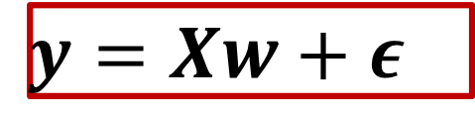
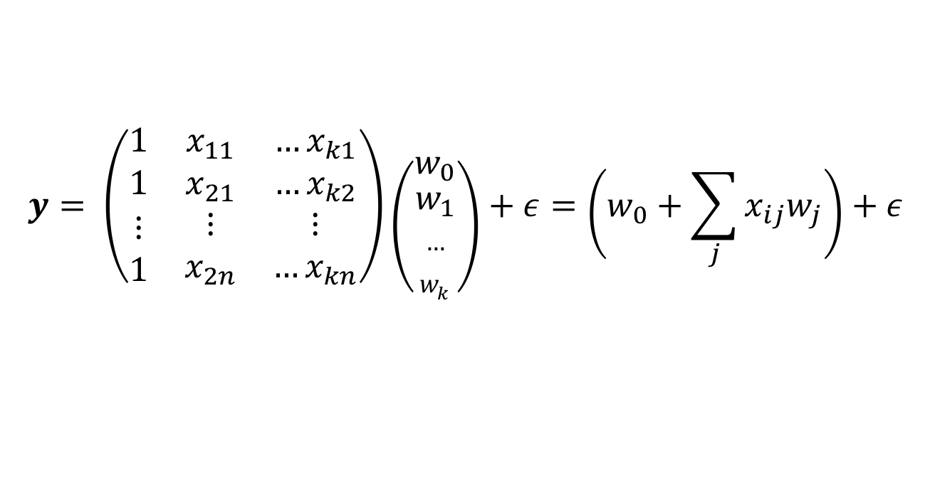
Linear Regression – Matrix notation
$$y=Xw+ε$$
14
$$y= \left(\begin{matrix}1 & x_{11} & …x_{k1} \\ 1 & x_{21} & {…x}_{k2} \\ \begin{aligned}⋮ \\ 1\end{aligned} & \begin{aligned}⋮ \\ x_{2n}\end{aligned} & \begin{aligned}⋮ \\ …x_{kn}\end{aligned}\end{matrix}\right)\left({w_{0} \atop \begin{aligned}w_{1} \\ … \\ w_{k}\end{aligned}}\right)+ε=\left(w_{0}+\sum_{j}{x_{ij}w_{j}}\right)+ε$$
Row by column

Slide 15
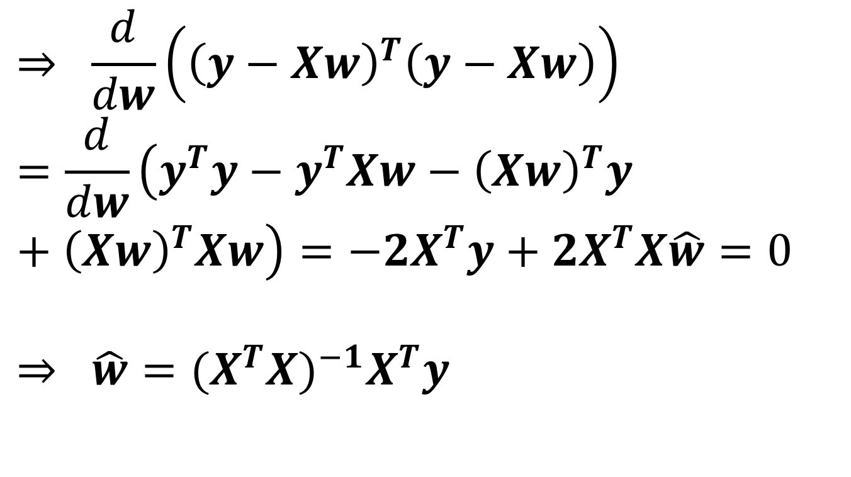

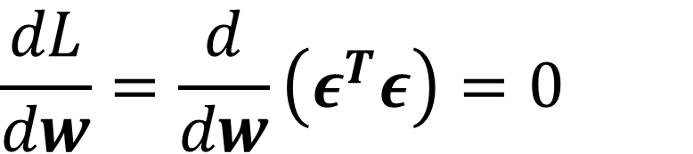
Multiple Linear Regression
$$y=Xw+ε$$
Minimizing the loss function, L (sum of squared errors):
$$\frac{dL}{dw}=\frac{d}{dw}\left(ε^{T}ε\right)=0$$
$$⇒ \frac{d}{dw}\left({\left(y−Xw\right)}^{T}\left(y−Xw\right)\right)=\frac{d}{dw}\left(y^{T}y−y^{T}Xw−{\left(Xw\right)}^{T}y+{\left(Xw\right)}^{T}Xw\right)=−2X^{T}y+2X^{T}X\hat{w}=0$$
$$⇒ \hat{w}={{(X}^{T}X)}^{−1}X^{T}y$$

Slide 16

Non-constant variance
$$σ\sim x^2$$
Truth
Fit

Slide 17
Non-constant variance
100 repetitions

Slide 18
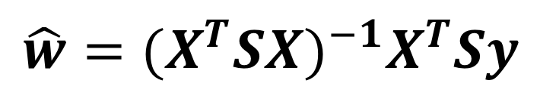
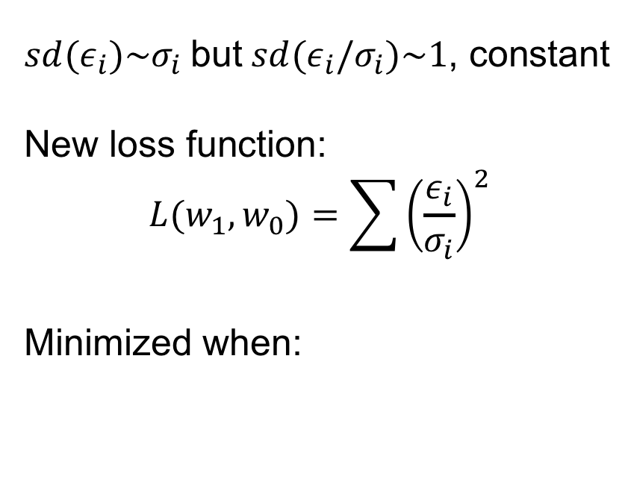
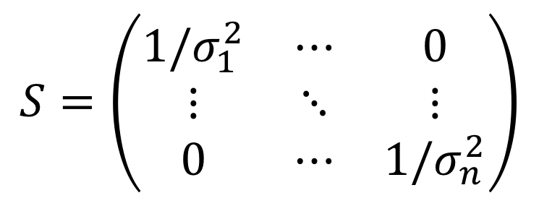
Weighted least squares
$sd(ε_{i})\sim σ_{i}$ but $sd(ε_{i}/σ_{i})\sim 1$, constant
New loss function:
$$L(w_{1},w_{0})=\sum{{\left(\frac{ε_{i}}{σ_{i}}\right)}^{2}}$$
Minimized when:
$$\hat{w}={{(X}^{T}SX)}^{−1}X^{T}Sy$$
$$S=\left(\begin{matrix}{1/σ}_{1}^{2} & ⋯ & 0 \\ ⋮ & ⋱ & ⋮ \\ 0 & ⋯ & {1/σ}_{n}^{2}\end{matrix}\right)$$

Slide 19

Weighted least squares
$$σ\sim x^2$$
100 repetitions

Slide 20

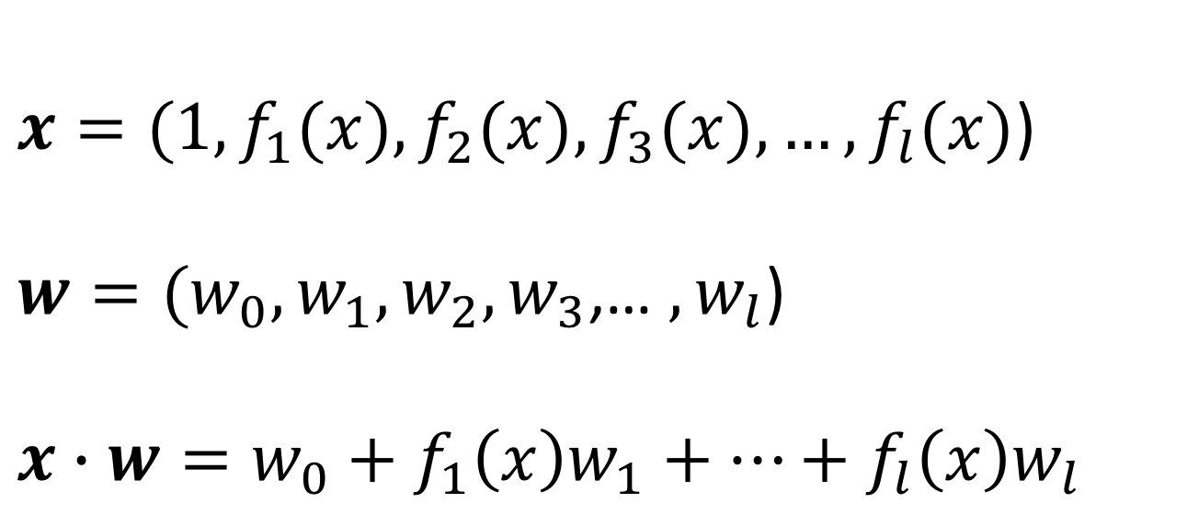
(Non)Linear Regression – Sum of Functions
$$y=x∙w+ε$$
20
$x=(1,f_{1}(x),f_{2}(x),f_{3}(x),…,f_{l}(x)$)
$w=(w_{0},w_{1},w_{2},w_{3}$,… $,w_{l}$)
$$x∙w=w_{0}+f_{1}\left(x\right)w_{1}+…+f_{l}\left(x\right)w_{l}$$

Slide 21
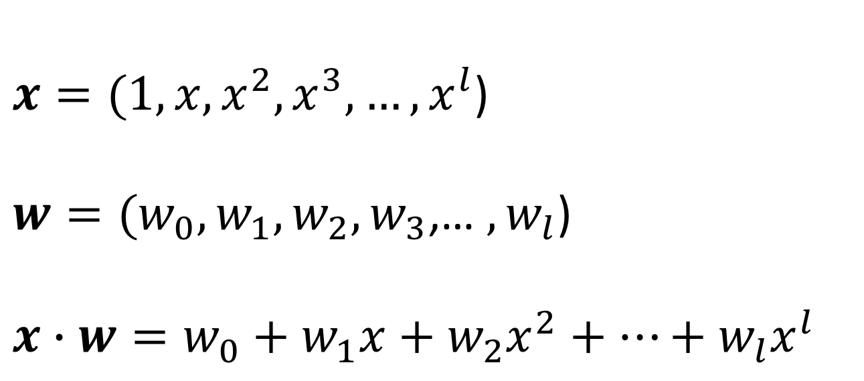
(Non)Linear Regression – Polynomial
$$y=x∙w+ε$$
21
$x=(1, x, x^{2},x^{3},…,x^{l}$)
$w=(w_{0},w_{1},w_{2},w_{3}$,… $,w_{l}$)
$$x∙w=w_{0}+w_{1}x+w_{2}x^{2}+…+w_{l}x^{l}$$

Slide 22
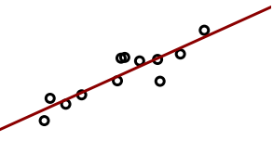
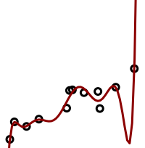
Model Capacity: Overfitting and Underfitting
22

Slide 23
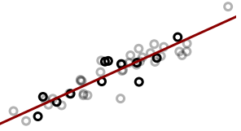
Model Capacity: Overfitting and Underfitting
23

Slide 24

Model Capacity: Overfitting and Underfitting
24

Slide 25
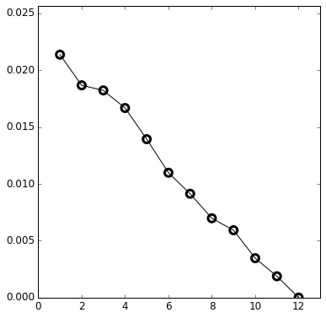
Model Capacity: Overfitting and Underfitting
25
Training Error
Error on Training Set
Degree of polynomial

Slide 26
Model Capacity: Overfitting and Underfitting
26
With four parameters I can fit an elephant, and with five I can make him wiggle his trunk.
John von Neumann

Slide 27
Training and Testing
Data
Set
Test
Training

Slide 28
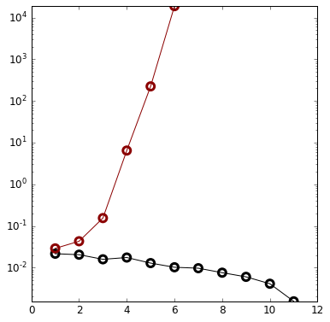
Training and Testing – Linear relationship
Error
Testing Error
Training Error
Degree of polynomial

Slide 29
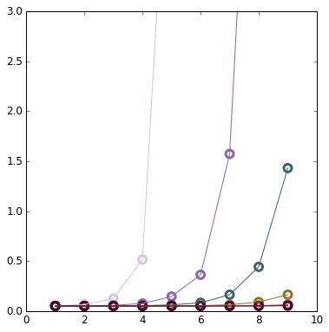
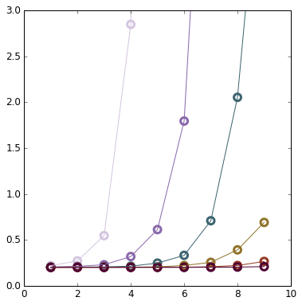
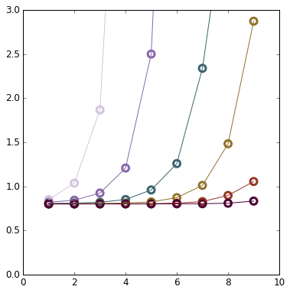
Testing Error and Training Set Size
Low Variance
High Variance
10
10
10
30
30
30
100
Error
100
300
1000
100
300
3000
Degree of polynomial
Degree of polynomial
Degree of polynomial

Slide 30
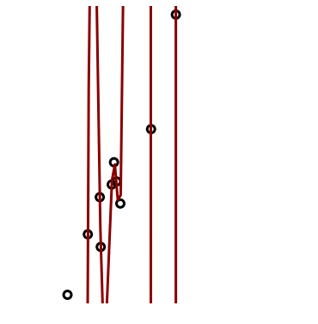
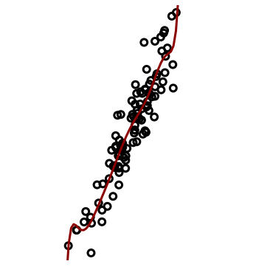
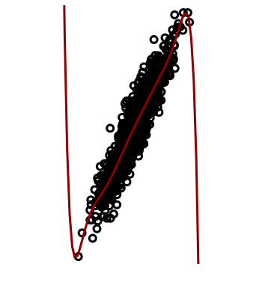
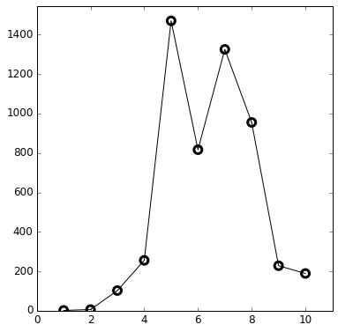
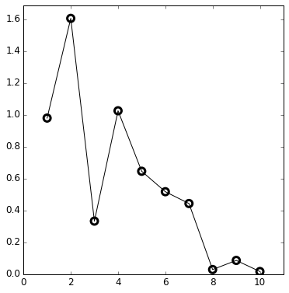
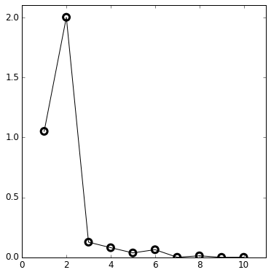
Coefficients and Training Set Size
Degree of
polynomial
= 9
10
100
1000
Absolute Value
of coefficient
Coefficient
Coefficient
Coefficient

Slide 31
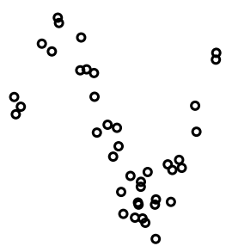
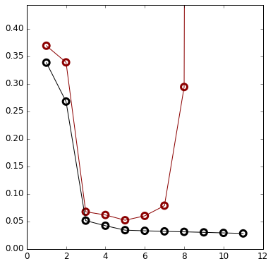
Training and Testing – Non-linear relationship
Error
Testing
Error
Training
Error
Degree of polynomial

Slide 32
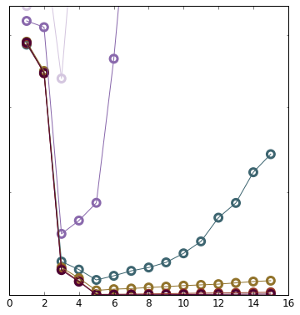
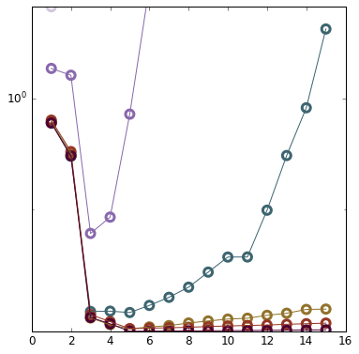
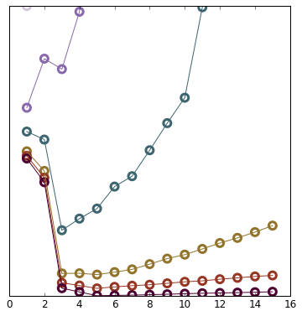
Testing Error and Training Set Size
Low Variance
High Variance
10
30
30
30
100
Log(Error)
100
100
300
300
300
1000
3000
Degree of polynomial
Degree of polynomial
Degree of polynomial

Slide 33
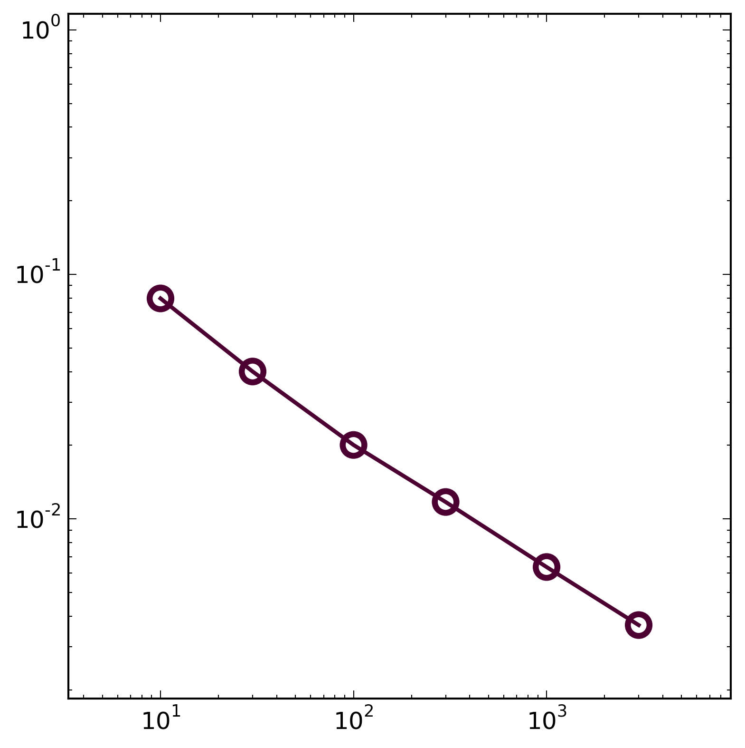
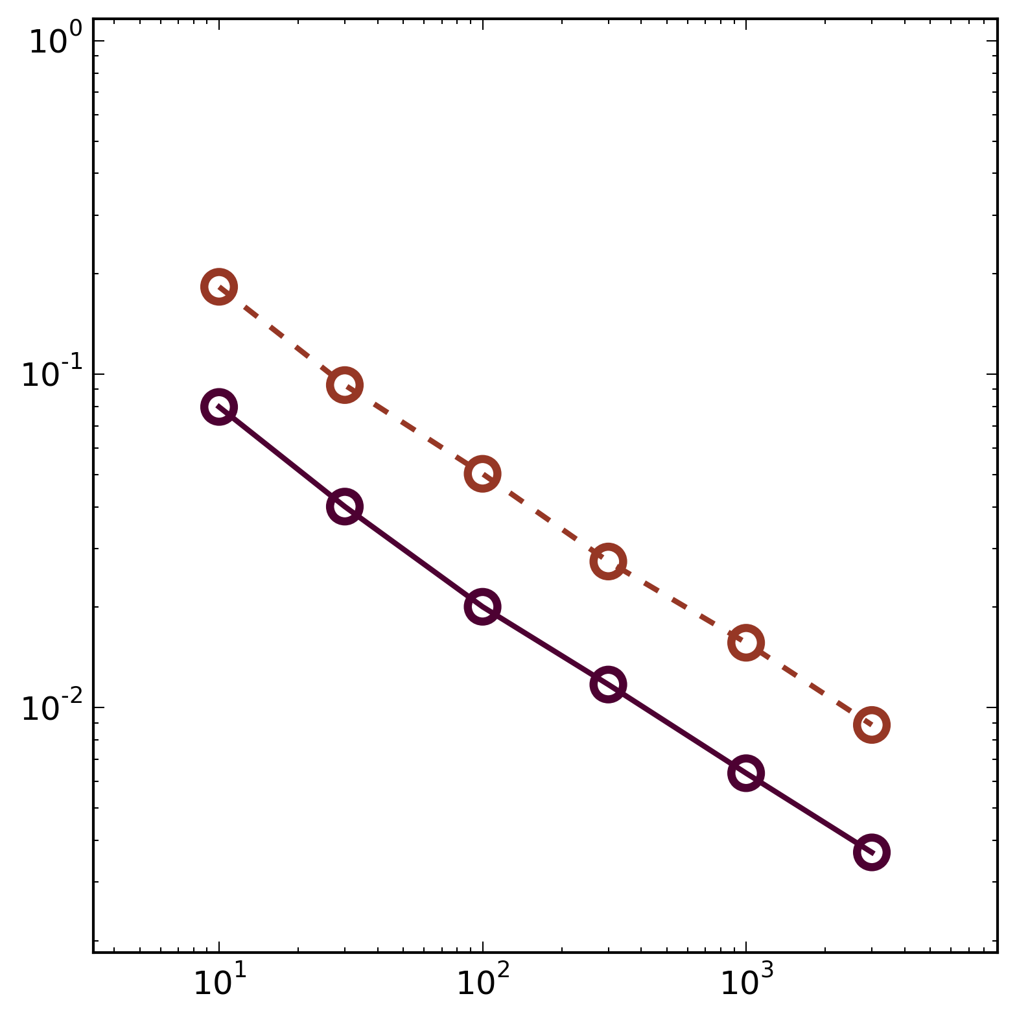
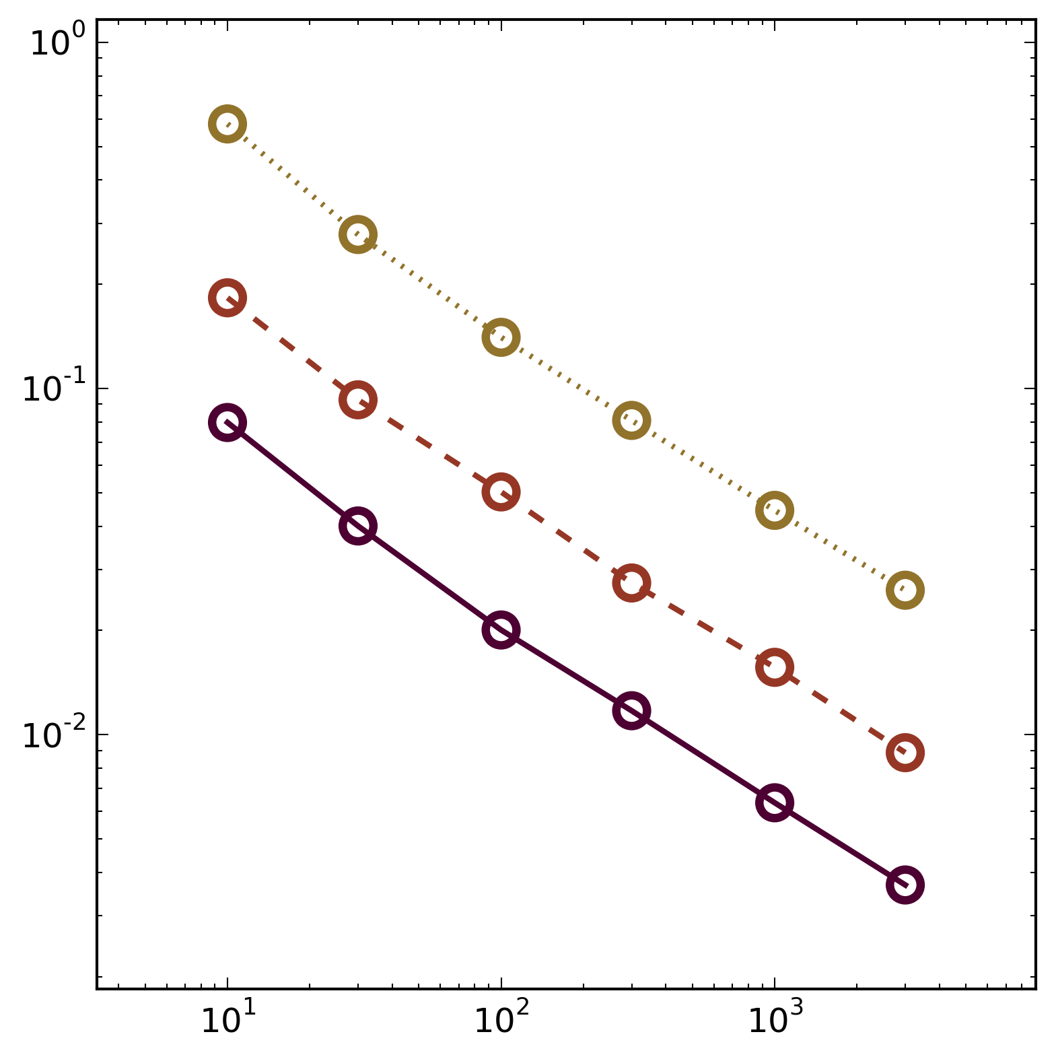
Multiple Linear Regression
R² = 0.99
Correlation of
independent
variables increase the
uncertainty in parameter determination
Standard deviation
R² = 0.9
Uncorrelated
Number of Data Points

Slide 34
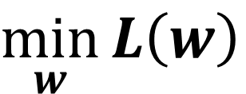
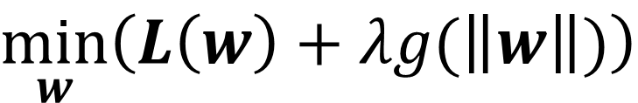
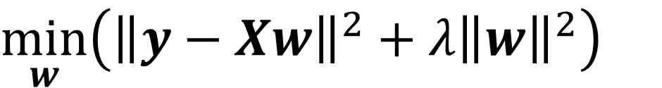
Regularization
No Regularization:
$$\min_{w}{L\left(w\right)}$$
Regularization:
$$\min_{w}\left(L\left(w\right)+λg(\left\|w\right\|)\right)$$
Ridge Regression:
$$\min_{w}\left({\left\|y−Xw\right\|}^{2}+λ{\left\|w\right\|}^{2}\right)$$

Slide 35
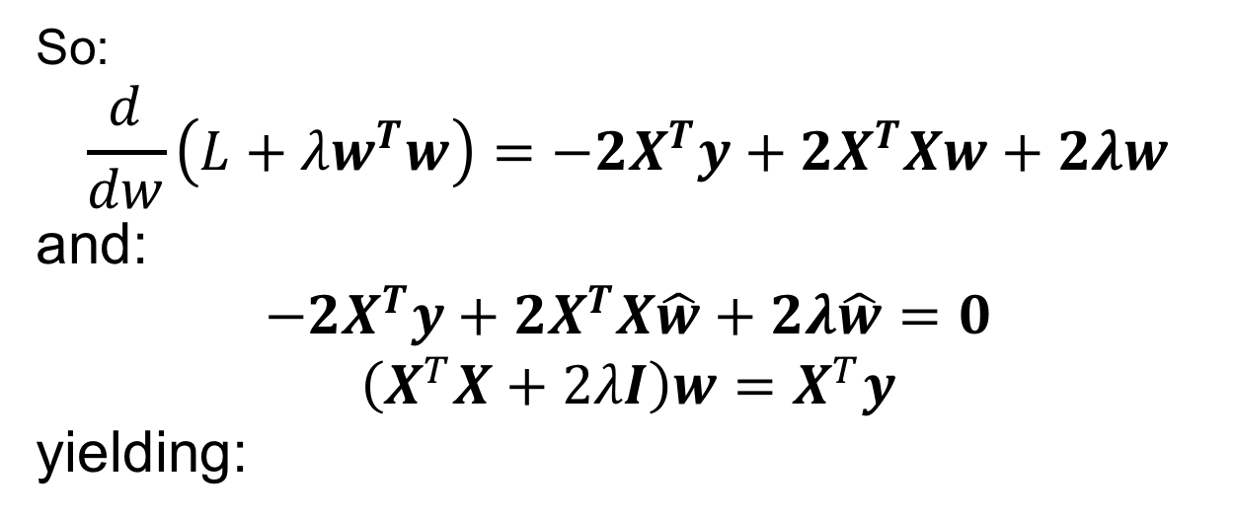
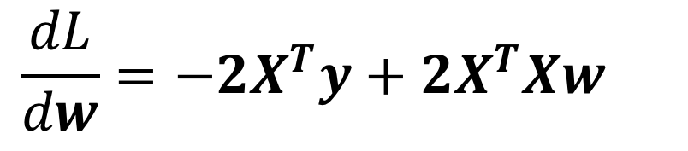
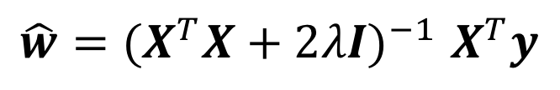
Ridge Regression
Recall:
$$\frac{dL}{dw}=−2X^{T}y+2X^{T}Xw$$
So:
$$\frac{d}{dw}\left(L+λw^{T}w\right)=−2X^{T}y+2X^{T}Xw+2λw$$
and:
$$−2X^{T}y+2X^{T}X\hat{w}+2λ\hat{w}=0$$
$$\left(X^{T}X+2λI\right)w=X^{T}y$$
yielding:
$$\hat{w}{=(X^{T}X+2λI)}^{−1}X^{T}y$$

Slide 36
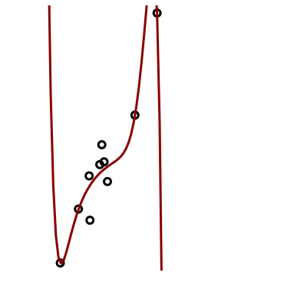


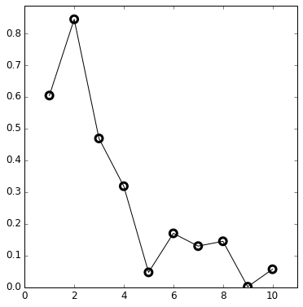
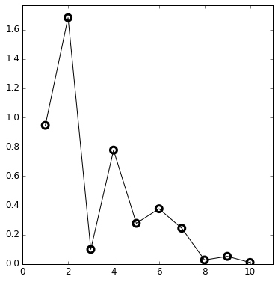

Regularization: Coefficients and Training Set Size
Degree of
polynomial
= 9
10
100
1000
Coefficient
Coefficient
Coefficient

Slide 37
Nearest Neighbor Regression – Fixed Distance

Slide 38
Nearest Neighbor Regression – Fixed Number (kNN)

Slide 39
Nearest Neighbor Regression
Estimate by taking the average over NNs
Or use a distance weighted average

Slide 40
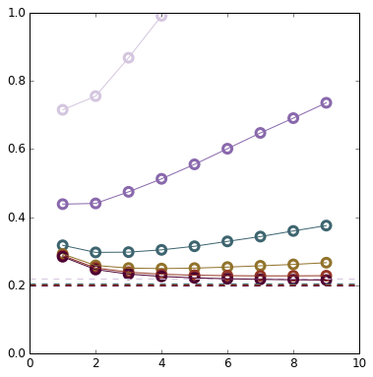
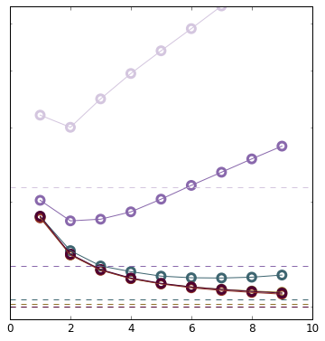
Nearest Neighbor Regression
Linear Data
Non-Linear Data
10
10
30
Error
Log(Error)
30
100
300
1000
100
3000
Number of Neighbors
Number of Neighbors

